Slide 1
Panel Discussion –
Benefits and Challenges using Commercial off-the-shelf for Ground System Mobility
David LaRoy (Moderator)
Technical Expert, U.S. Army DEVCOM GVSC
DISTRIBUTION STATEMENT A. Approved for public release; distribution is unlimited. OPSEC #10984

Slide 2
Objectives from the 2025 DoW Acquisition Transformation Strategy
Accelerate Commercial Preference: Maximize purchase of products, services, and parts available in the commercial marketplace to avoid additional cost and schedule.
Procure Industry-Driven Solutions: Prioritize the purchase of equipment and weapons that meet our needs faster, even when they do not meet every requirement.

Slide 3
GVSC S&T Strategy - COTS
Build bridges to new commercial tech:
Scouting, Industry Days, Tech Interchanges, Conferences, xTech, SBIRs
Break barriers to entry for commercial tech:
    Faster/flexible contracting
        Pathway for Innovation & Technology (PIT)
        Defense Innovation Unit (DIU)
        Commercial Solutions Opening (CSO)
Leverage GVSC vehicle expertise to help commercial suppliers successfully integrate COTS components on Army platforms
Testing & Experimentation:
  Use GVSC labs to evaluate commercial tech
  Provide opportunities for on-vehicle experimentation under military use-cases
Focused investment:
  Fill gaps in commercial capability
  Under-commercialized tech areas

Slide 4

Brody Ringler Chief Engineer, MATBOCK LLC

Slide 5

Isaac Rife Program Engineering Manager, BAE Systems

Slide 6
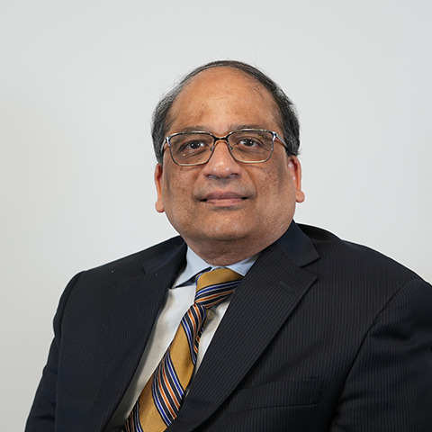
Ramprasad (Ram) Krishnamachari
Power & Mobility – Principal Engineer, General Dynamics Land Systems

Slide 7

Mark Van Wingerden
Global Product Strategy Manager, EATON

